Slide 1
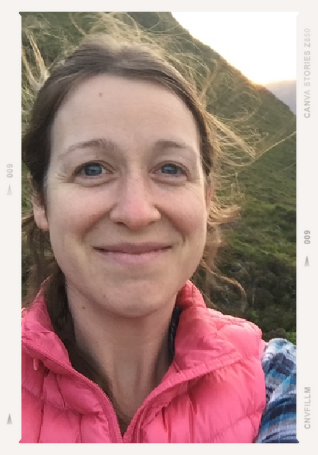
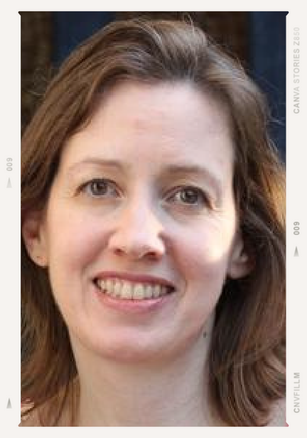
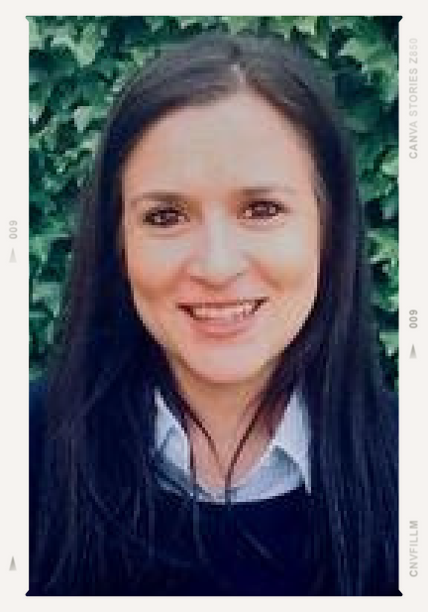
These Are Our Stories:
Fostering Resilience and Community with Student-Created PhD Storybooks
An Enhancement Theme project
Teresa Griffin
PhD Student, School of Psychology & Neuroscience
Dr Malinda Carpenter
Professor, School of Psychology & Neuroscience
Dr Natalia Sassu Suarez Ferri
Lecturer, School of Art History

Slide 2
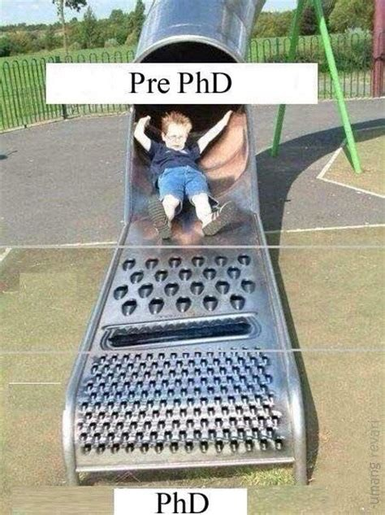

Slide 3
RESILIENCE ?
= STORY

Slide 4
RESILIENCE = STORY
Achieving positive outcomes in adversity

Slide 5
STORY
RESILIENCE = STORY
Achieving positive outcomes in adversity

Slide 6
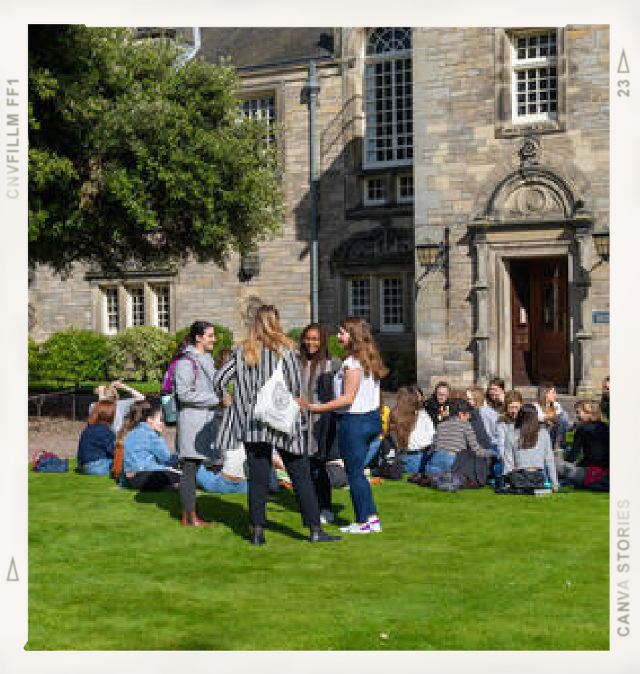
WHO SHOWS RESILIENCE ?
= STORY

Slide 7
RESILIENCE = COMMUNITY
STORY

Slide 8
Storybook Workshops
Fostering resilience and community wi^{th}
student-created storybook^{s about shared struggles.}
I had a difficult time at first before I reached ou^{t}
to others...It was so helpfu^{l to share...}

Slide 9
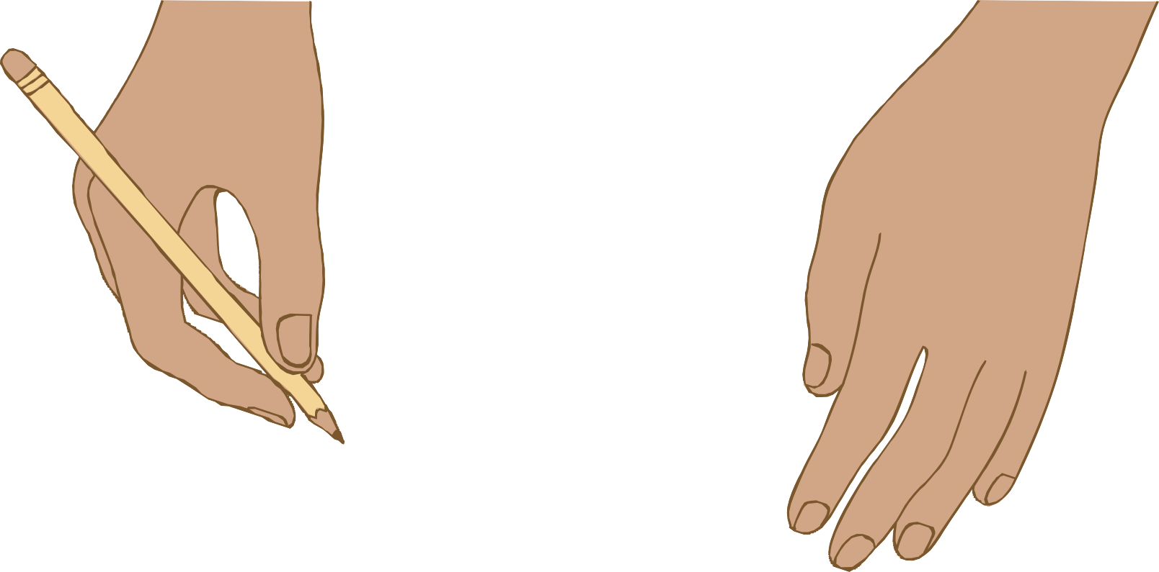

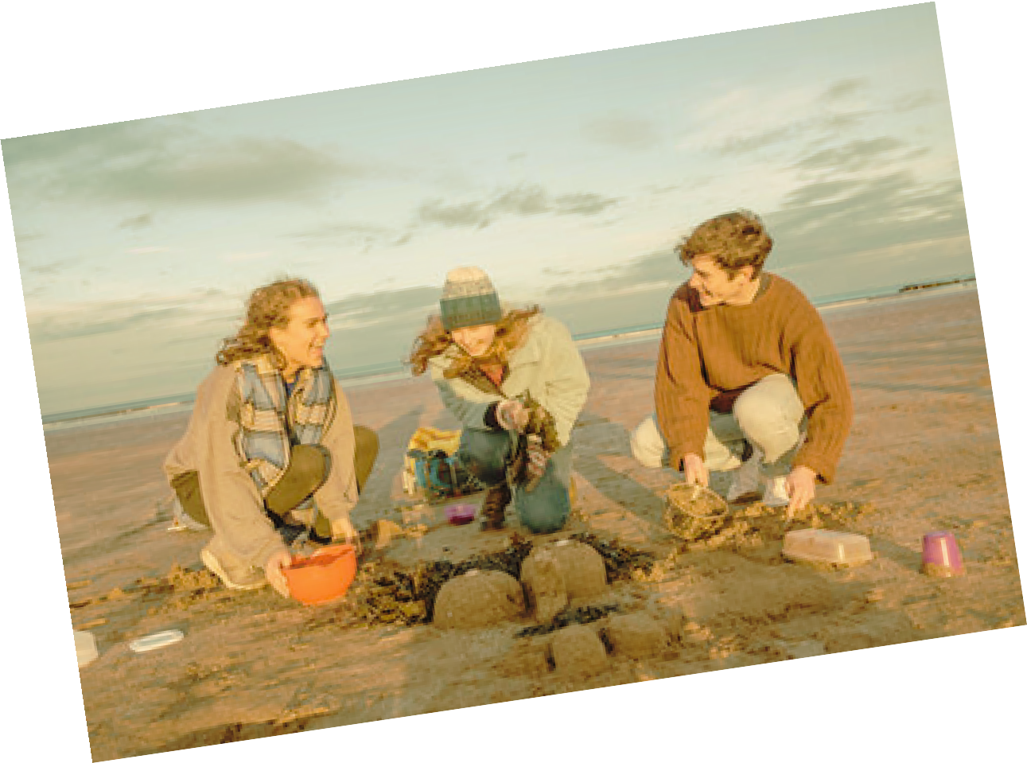

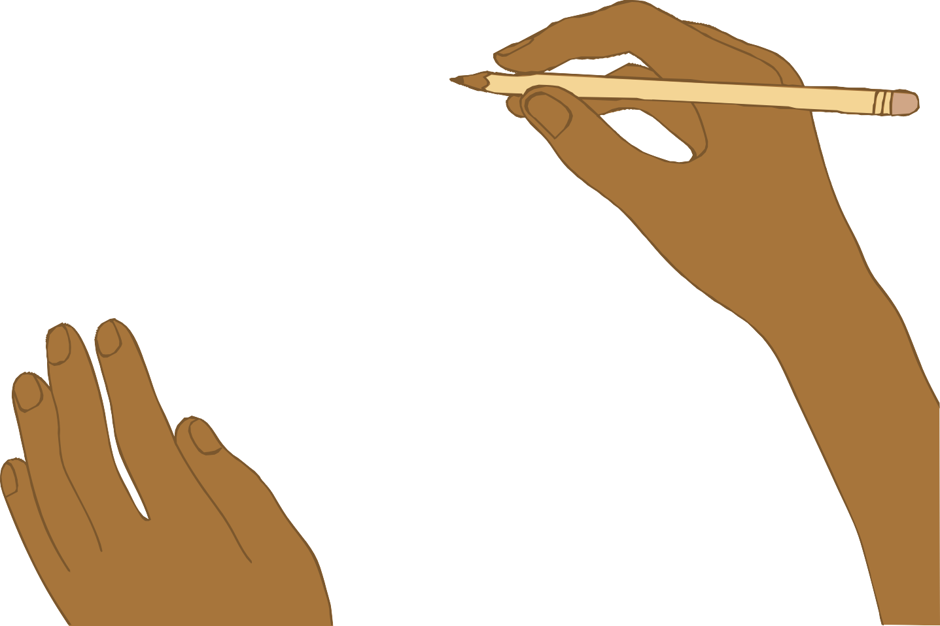
Storybook Workshops
PhD students within Schools
Fostering resilience and community wi^{th}
student-created storybook^{s about shared struggles.}
I had a difficult time at first before I reached ou^{t}
to others...It was so helpfu^{l to share...}

Slide 10



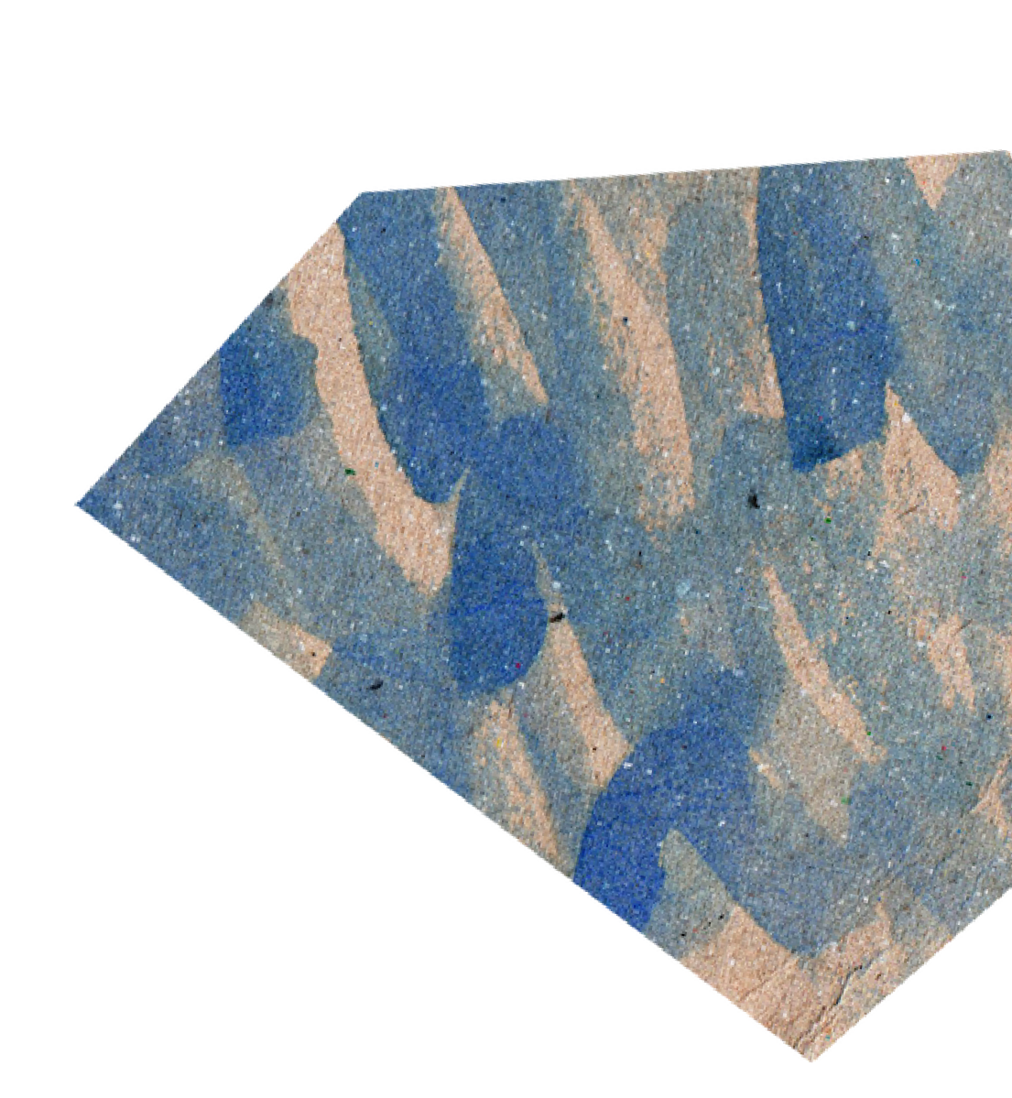

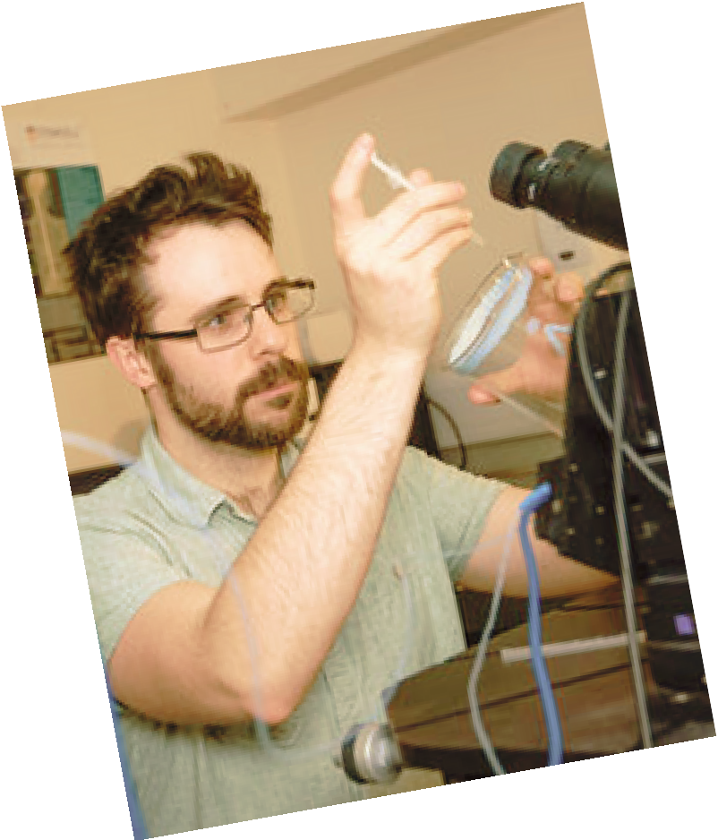


Storybook Workshops
PhD students within Schools
Psych & Neuro, Art History, and ?
Fostering resilience and community wi^{th}
student-created storybook^{s about shared struggles.}
I had a difficult time at first before I reached ou^{t}
to others...It was so helpfu^{l to share...}

Slide 11



Storybook Workshops
PhD students within Schools
Psych & Neuro, Art History, and ?
prompts & activities
Fostering resilience and community wi^{th}
student-created storybook^{s about shared struggles.}
I had a difficult time at first before I reached ou^{t}
to others...It was so helpfu^{l to share...}

Slide 12


Storybook Workshops
PhD students within Schools
Psych & Neuro, Art History, and ?
prompts & activities
physical books
Fostering resilience and community wi^{th}
student-created storybook^{s about shared struggles.}
I had a difficult time at first before I reached ou^{t}
to others...It was so helpfu^{l to share...}

Slide 13



Storybook Workshops
PhD students within Schools
Psych & Neuro, Art History, and ?
prompts & activities
physical books
digital version of finished books
Fostering resilience and community wi^{th}
student-created storybook^{s about shared struggles.}
I had a difficult time at first before I reached ou^{t}
to others...It was so helpfu^{l to share...}

Slide 14
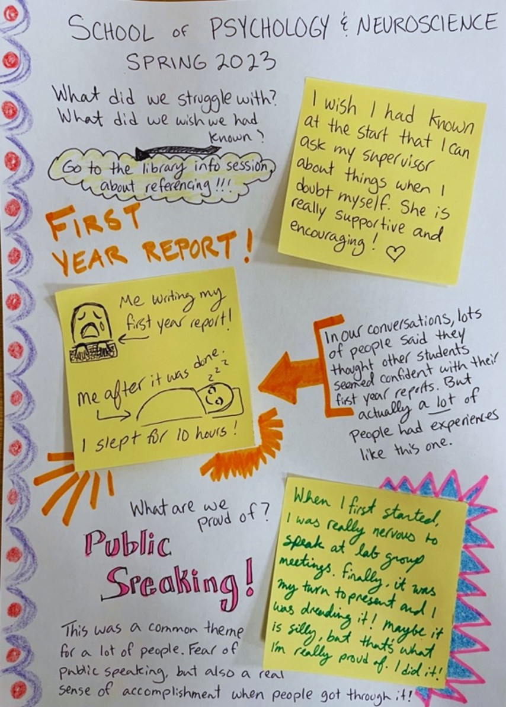
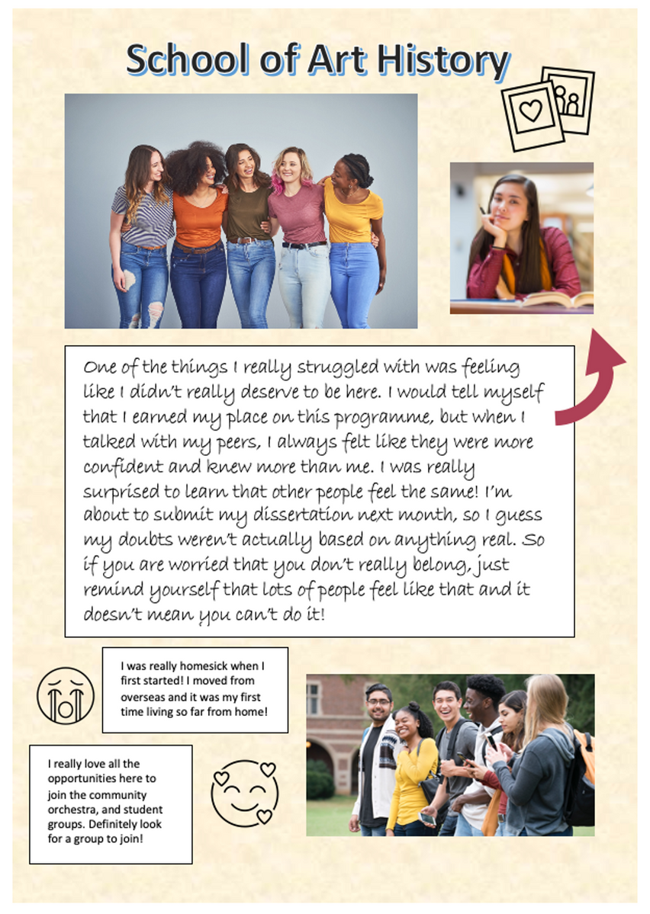

Slide 15
Storybook Workshops
empower students to tell their own stories
social validation
normalise diversity of experience share tips and resources strengthen community
Fostering resilience and community wi^{th}
student-created storybook^{s about shared struggles.}
I had a difficult time at first before I reached ou^{t}
to others...It was so helpfu^{l to share...}

Slide 16
Storybook Workshops
measure impact before & after
Fostering resilience and community wi^{th}
student-created storybook^{s about shared struggles.}
I had a difficult time at first before I reached ou^{t}
to others...It was so helpfu^{l to share...}

Slide 17
Storybook Workshops
measure impact before & after
storybooks as gifts to the next cohort
Fostering resilience and community wi^{th}
student-created storybook^{s about shared struggles.}
I had a difficult time at first before I reached ou^{t}
to others...It was so helpfu^{l to share...}

Slide 18
Storybook Workshops
measure impact before & after storybooks as gifts to the next cohort storybooks with orientation
Fostering resilience and community wi^{th}
student-created storybook^{s about shared struggles.}
I had a difficult time at first before I reached ou^{t}
to others...It was so helpfu^{l to share...}

Slide 19
Storybook Workshops
measure impact before & after
storybooks as gifts to the next cohort storybooks with orientation workshop procedure
Fostering resilience and community wi^{th}
student-created storybook^{s about shared struggles.}
I had a difficult time at first before I reached ou^{t}
to others...It was so helpfu^{l to share...}

Slide 20
Storybook Workshops
measure impact before & after
storybooks as gifts to the next cohort storybooks with orientation workshop procedure
workshops in other Schools...
Fostering resilience and community wi^{th}
student-created storybook^{s about shared struggles.}
I had a difficult time at first before I reached ou^{t}
to others...It was so helpfu^{l to share...}

Slide 21
Storybook Workshops
measure impact before & after
storybooks as gifts to the next cohort storybooks with orientation workshop procedure
workshops in other Schools... ongoing workshops...
Fostering resilience and community wi^{th}
student-created storybook^{s about shared struggles.}
I had a difficult time at first before I reached ou^{t}
to others...It was so helpfu^{l to share...}

